Slide 1
The Tragedy of Hamlet, Prince of Denmark
William Shakespeare

Slide 2
Publication
Written during the first part of the seventeenth century (probably in 1600 or 1601), Hamlet was probably first performed in July 1602. It was first published in printed form in 1603 and appeared in an enlarged edition in 1604.

Slide 3
Genre
Revenge
Tragedy

Slide 4
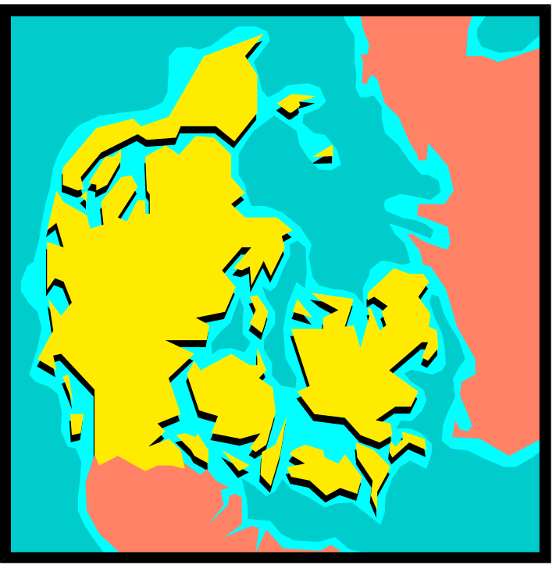
Setting
Denmark during the late middle ages (circa 1200), though characters in the play occasionally reference things or events from the Elizabethan Age (circa 1500).

Slide 5
Historical Relevance
Story of Hamlet based on a Danish revenge story from the 1100s -Shakespeare modified to fill with dread and uncertainty…
Product of Reformation (Protestants broke away from church & skeptical humanism)
  Hamlet has constant anxiety about appearance vs. reality, concerns with religion (related to the Reformation)

Slide 6
CHARACTERS…

Slide 7
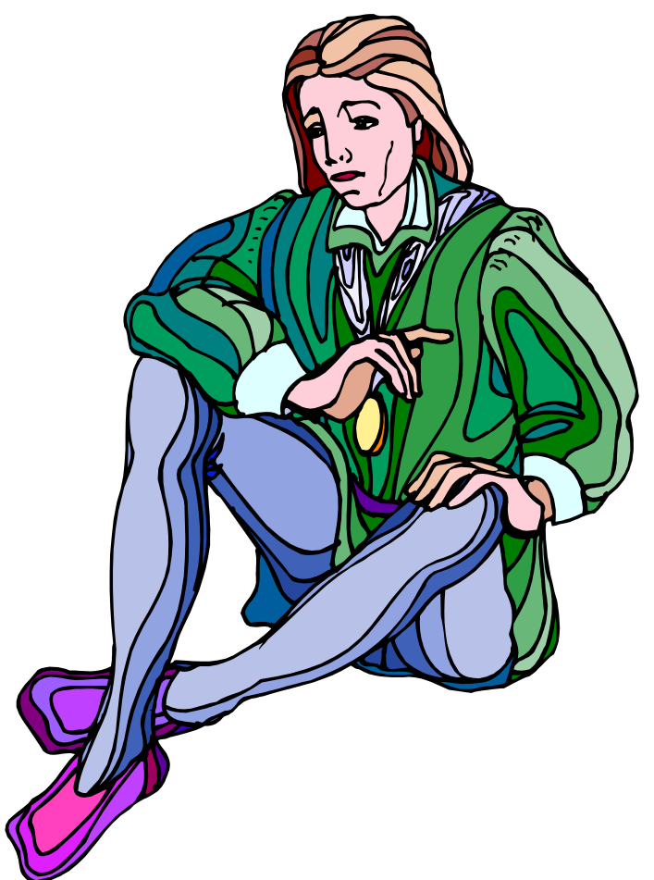
Hamlet
The Prince of Denmark, the title character, and the protagonist. About thirty years old at the start of the play, Hamlet is the son of Queen Gertrude and the late King Hamlet, and the nephew of the present king, Claudius.

Slide 8
Hamlet continued
Hamlet is melancholic, bitter, and cynical, full of hatred for his uncle's scheming and disgust for his mother's sexuality. A reflective and thoughtful young man who has studied at the University of Wittenberg, Hamlet is sometimes indecisive and hesitant, but at other times prone to rash and impulsive acts.

Slide 9
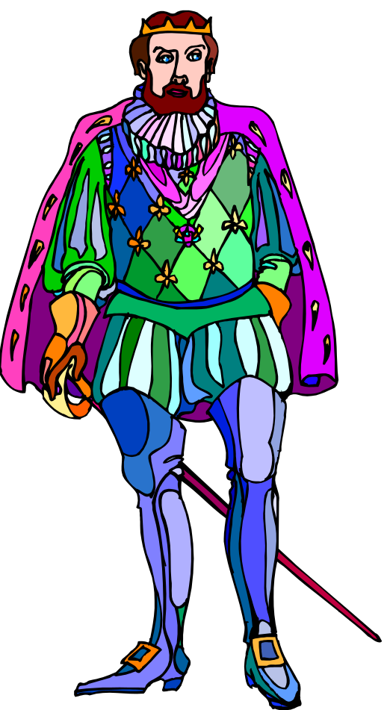
Claudius
The King of Denmark, Hamlet's uncle, and the play's antagonist. The villain of the play, Claudius is a calculating, ambitious politician, driven by his sexual appetites and his lust for power, but he occasionally shows signs of guilt and human feeling—his love for Gertrude, for instance, seems sincere.

Slide 10
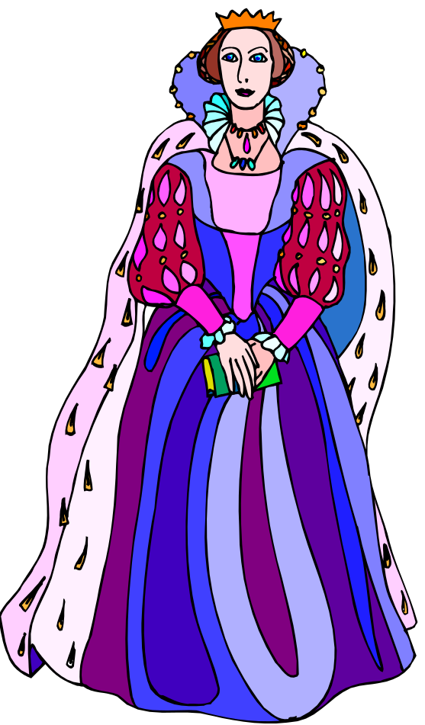
Gertrude
The Queen of Denmark, Hamlet's mother, recently married to Claudius. Gertrude loves Hamlet deeply, but she is a shallow, weak woman who seeks affection and status more urgently than moral rectitude or truth.

Slide 11
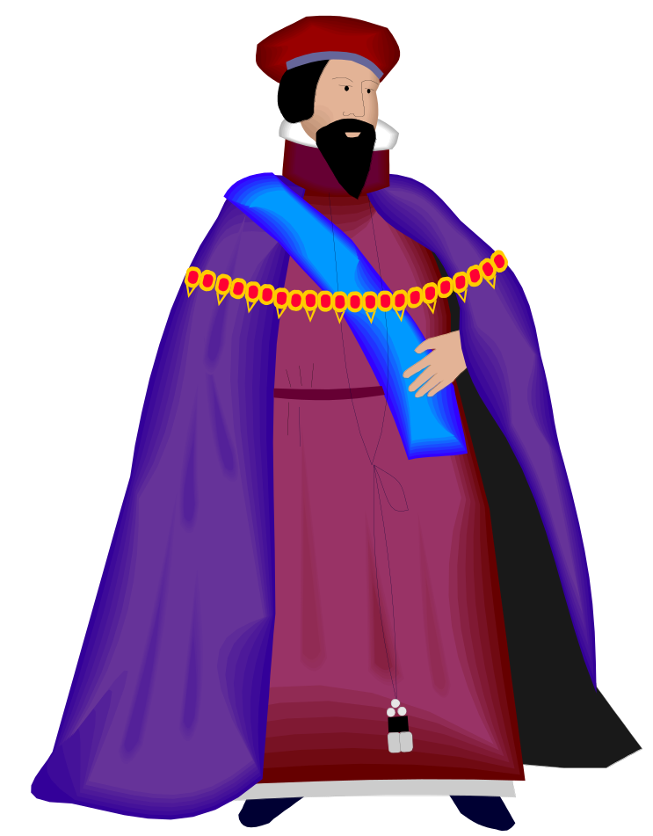
Polonius
The Lord Chamberlain of Claudius's court, a pompous, conniving old man. Polonius is the father of Laertes and Ophelia.

Slide 12
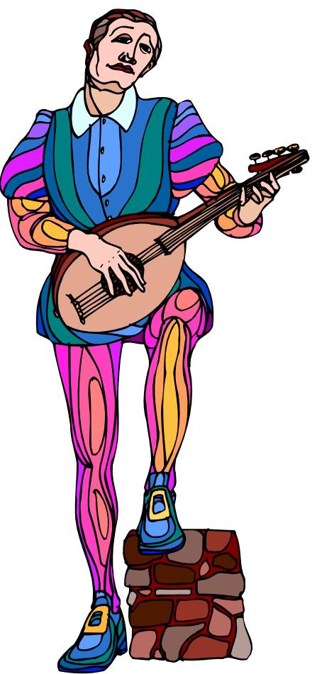
Horatio
Hamlet's close friend, who studied with the prince at the university in Wittenberg. Horatio is loyal and helpful to Hamlet throughout the play. After Hamlet's death, Horatio remains alive to tell Hamlet's story.

Slide 13
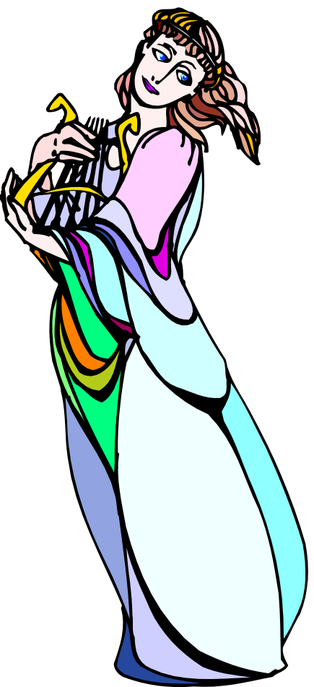
Ophelia
Polonius's daughter, a beautiful young woman with whom Hamlet has been in love. Ophelia is a sweet and innocent young girl, who obeys her father and her brother, Laertes.

Slide 14
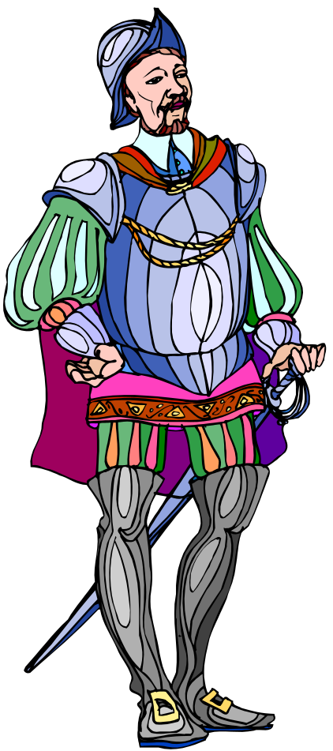
Laertes
Polonius's son and Ophelia's brother, a young man who spends much of the play in France. Passionate and quick to action, Laertes is clearly a foil for the reflective Hamlet.

Slide 15
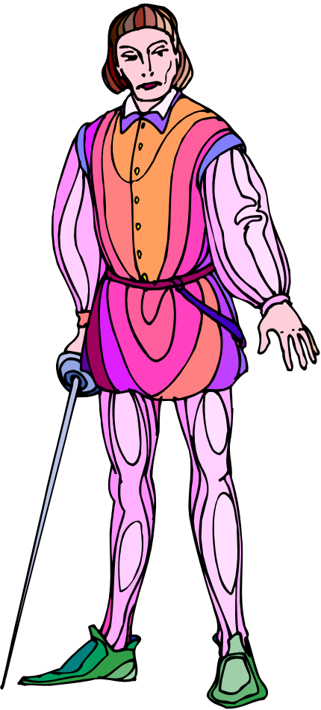
Fortinbras
The young Prince of Norway, whose father the king (also named Fortinbras) was killed by Hamlet's father (also named Hamlet). Now Fortinbras wishes to attack Denmark to avenge his father's honor, making him another foil for Prince Hamlet.

Slide 16
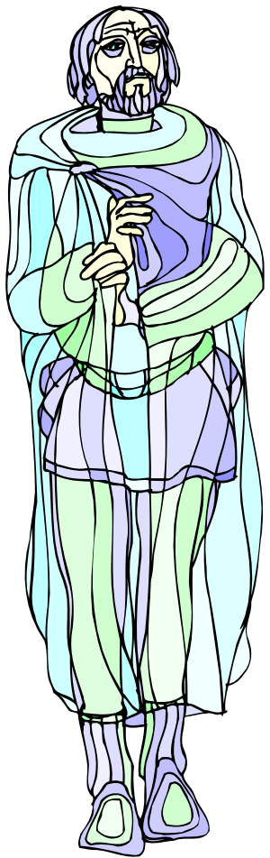
The Ghost
The specter of Hamlet's recently deceased father. The ghost, who claims to have been murdered by Claudius, calls upon Hamlet to avenge him.

Slide 17
The Ghost continued
It is not entirely certain whether the ghost is what it appears to be, or whether it is something else. Hamlet speculates that the ghost might be a devil sent to deceive him and tempt him into murder, and the question of what the ghost is or where it comes from is never definitively resolved.

Slide 18

Rosencrantz and Guildenstern
Two slightly bumbling courtiers, former friends of Hamlet from Wittenberg, who are summoned by Claudius and Gertrude to discover the cause of Hamlet's strange behavior.

Slide 19
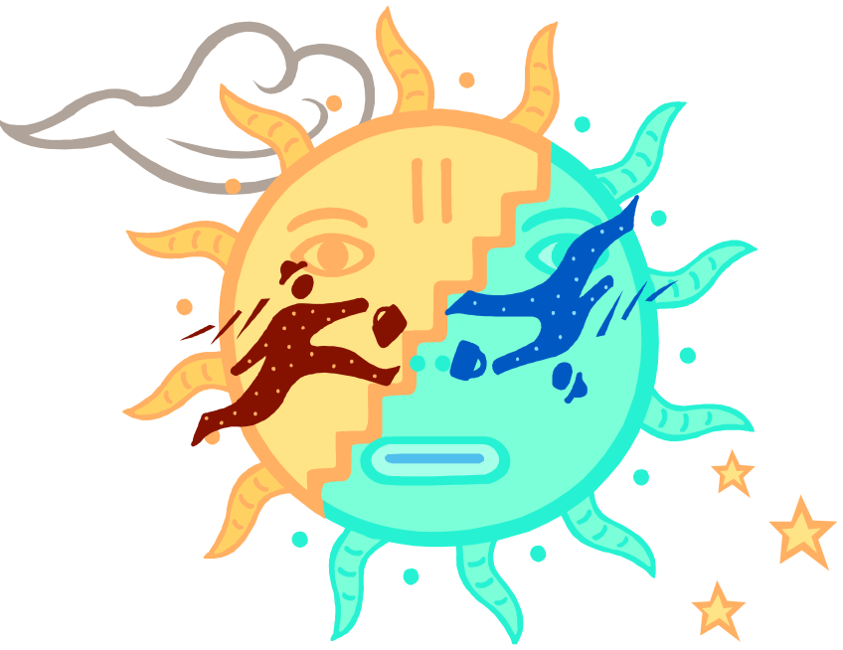
Themes
Themes are the fundamental and often universal ideas explored in a literary work.

Slide 20
Appearance vs. Reality
Appearance doesn’t match reality often.
  Hamlet struggles to determine who his true friends are
  Claudius appears to be a true and just king and Gertrude his virtuous queen
  Rosencrantz and Guildenstern appear to be true friends, etc.

Slide 21
Sanity vs. Insanity
In many ways this theme is intertwined with the theme of appearance vs. reality. Hamlet’s sanity or insanity has baffled critics for years. Even the characters in the play discuss inconsistencies in Hamlet’s behavior, sometimes assuming he is really insane, at other times amazed by his clarity of thought.

Slide 22
Theme of Certainty
What separates Hamlet from other revenge plays (and maybe from every play written before it) is that the action we expect to see, particularly from Hamlet himself, is continually postponed while Hamlet tries to obtain more certain knowledge about what he is doing. This play poses many questions that other plays would simply take for granted.

Slide 23
Theme of Uncertainty
Many people have seen Hamlet as a play about indecisiveness, and thus about Hamlet's failure to act appropriately. It might be more interesting to consider that the play shows us how many uncertainties our lives are built upon, how many unknown quantities are taken for granted when people act or when they evaluate one another's actions.

Slide 24

Theme of Action vs. Inaction
Directly related to the themes of certainty and uncertainty is the theme of action. How is it possible to take reasonable, effective, purposeful action? Is it possible to act without taking action?

Slide 25

Death
In the aftermath of his father's murder, Hamlet is obsessed with the idea of death, and over the course of the play he considers death from a great many perspectives.

Slide 26
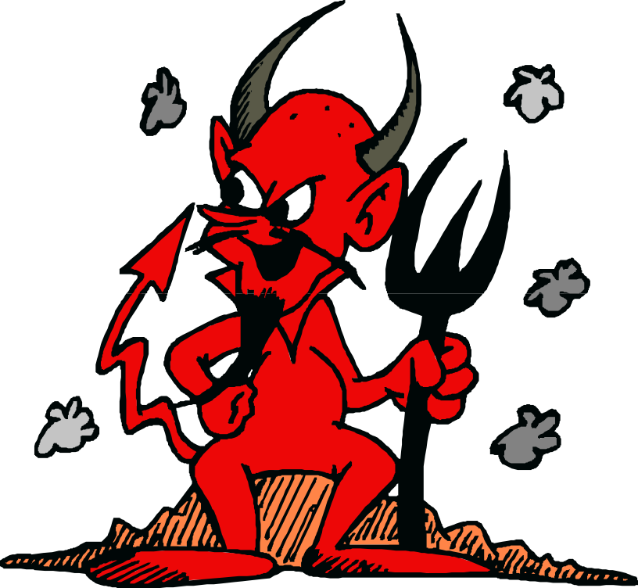
Decay and Corruption
Among the most powerful images of the play are those which reveal disintegrating situations, both in personal terms for Prince Hamlet, and in political terms for Denmark.

Slide 27

Revenge
Since death is both the cause and the consequence of revenge, it is intimately tied to the theme of revenge and justice—Claudius's murder of King Hamlet initiates Hamlet's quest for revenge, and Claudius's death is the end of that quest.

Slide 28
The End

